Slide 1
Python Basics
Mr. Fahad Amin
Lecturer Dept. of Computer Science
COMSATS University Islamabad

Slide 2
Python Print Statement
print('Good Morning!')
print('It is rainy today')

Slide 3
Python print() with end Parameter
# print with end whitespace
print('Good Morning!', end= ' ')
print('It is rainy today')

Slide 4
print() with sep parameter
print('New Year', 2023, 'See you soon!', sep= '. ')

Slide 5
Example: Print Python Variables and Literals
number = -10.6
name = “Ai"
# print literals
print(5)
# print variables
print(number)
print(name)

Slide 6
Print Concatenated Strings
print(‘Ai in Python is ' + 'awesome.')

Slide 7
Python User Input
# using input() to take user input
num = input('Enter a number: ')
print('You Entered:', num)
print('Data type of num:', type(num))

Slide 8
Data Type
num = input('Enter a number: ')
print('Data type of num:', type(num))
To convert user input into a number we can use int() or float() functions as:
num = int(input('Enter a number: '))

Slide 9
Example: Python if Statement
if number > 0:
print('Positive number')
elif number < 0:
print('Negative number')
else:
print('Zero')
print('This statement is always executed')

Slide 10
Find the greatest roll number among 5 roll Numbers

Slide 11
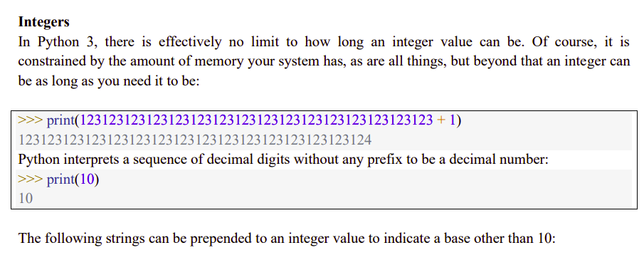

Slide 12
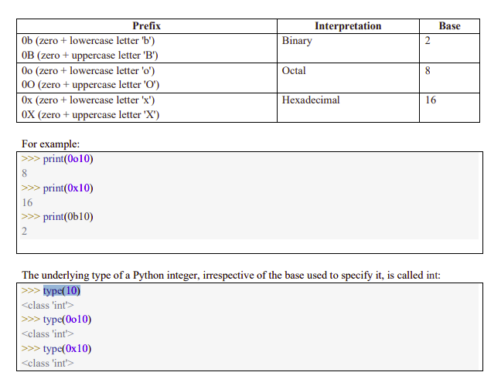

Slide 13
Functions
def function ():
print("wow")
function()

Slide 14
Functions
def add_numbers(x, y):
This function adds two numbers and returns the result.
return x + y
# Calling the function and storing the result
result = add_numbers(3, 5)
print(result)
# Output: 8

Slide 15
Modules
File A (saved as py)
def function ():
print(“Fuction written in File A")
File B
import a
a.function()

Slide 16
palindrome
def palindrome(s):
Normalize the string by converting it to lowercase
s = s.lower()
Compare the string with its reverse
if s == s[::-1]:
print("palindrome")
else:
print("Not palindrome")
palindrome("Racecar")
palindrome("Python")

Slide 17
For loop
Looping over a list
fruits = ["apple", "banana", "cherry"]
for i in fruits:
print(i)
Looping over a range of numbers
for i in range(5):
print(i)

Slide 18
While loop
Looping with a while loop
count = 0
while count < 5:
print(count)
count += 1

Slide 19
Loop Control Statements
for i in range(10):
if i == 5:
break // or Continue
print(i)

Slide 20
Nested for loops
for i in range(3):
for j in range(2):
print(i,j)

Slide 21
Write a Python code to accept an integer value from user and check that whether the given value is prime number or not.

Slide 22
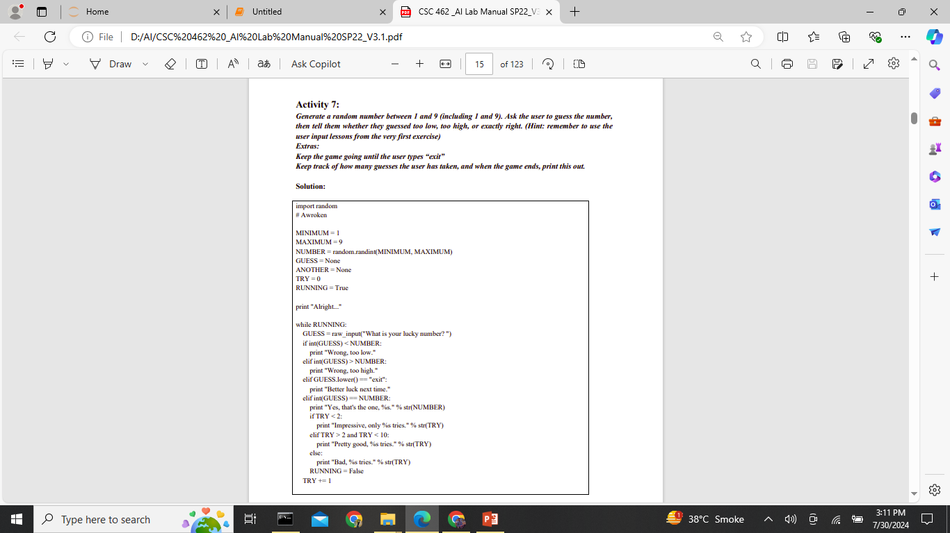
1st Artificial Intelligence game

Slide 23
MINIMUM and MAXIMUM set the range for the random number.
NUMBER is assigned a random integer between MINIMUM and MAXIMUM (inclusive) using random.randint().
GUESS is initialized to None. This will store the user's guess.
TRY is initialized to 0. This will count the number of attempts the user has made.
RUNNING is a boolean variable set to True, which controls the while loop.

Slide 24
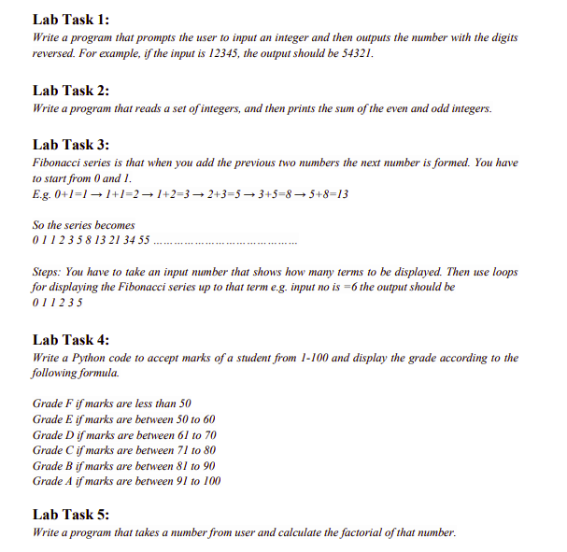

Slide 25
List Data Structure
List = [2,4,6]
print("Blank List: ")
print(List)

Slide 26
# Create a list
my_array = [1, 2, 3, 4, 5]
# Accessing elements in the list
print("First element:", my_array[0])
# Adding an element to the list
my_array.append(6)
# add multiple elements
my_array.extend([2,3,4,5,6,7])
# insert element at specific position
my_array.insert(2,3)
# reverse list
my_array.reverse()
# Removing an element from the list
my_array.remove(3)
# Slicing the list
print("Sliced list:", my_array[1:4])
# Clear List
my_array.clear

Slide 27
Sorting list with built in method
list=[3,4,6,0,1]
list.sort()
list.sort(reverse=True)
print(list)

Slide 28
Creating a List of strings and accessing using index
List = [“Artificial", “intelligence", “CS"]
print("\nList Items: ")
print(List[0])
print(List[2])

Slide 29
Multi-Dimensional List
List = [[‘A', 'For'], [‘Apple']]
print("\nMulti-Dimensional List: ")
print(List)

Slide 30
A list may contain duplicate values with their distinct positions and hence, multiple distinct or duplicate values can be passed as a sequence at the time of list creation.
List = [1, 2, 4, 4, 3, 3, 3, 6, 5]
List = [1, 2, 'Geeks', 4, 'For', 6, 'Geeks']

Slide 31
Knowing the size of List
print(len(List1))

Slide 32
Addition of elements in a List
List.append(1)
List.append(2)
List.append(4)

Slide 33
Filling list with loop and Addition of a Tuple
List = []
print("Initial blank List: ")
print(List)
for i in range(1, 5):
List.append(i)
print("\nList after Addition of elements from 1-4: ")
print(List)
List.append((5, 6))
print("\nList after Addition of a Tuple: ")
print(List)

Slide 34
Addition of 2 lists
# Initial lists
List1 = [1, 2, 3]
List2 = [4, 5, 6]
List1.extend(List2) // list3=list1+list2
print("List after Addition using extend: ")
print(List1)

Slide 35
Linear search
my_array = [10, 20, 30, 40, 50]
target = 30
index = 0
while index < len(my_array):
if my_array[index] == target:
print(“found at index”, index)
break
index += 1
else:
print(“not found in the array")

Slide 36
Liner search in list
list = [10, 5, 7, 2, 8, 12]
target = 7
# Variable to hold the index of the target
index_found = -1
for i in range(len(list)):
if list[i] == target:
index_found = i
break # Exit the loop once the target is found
if index_found != -1:
print(f"Target {target} found at index {index_found}")
else:
print(f"Target {target} not found in the list")

Slide 37
Dictionary in python
# Creating a dictionary to store names and ages
person_dict = {
"Alice": 30,
"Bob": 25,
}
# Accessing values in the dictionary
print(person_dict["Alice"])
print("Age of Bob:", person_dict["Bob"])

Slide 38
Dictionary Operations
# Adding a new entry
person_dict["Frank"] = 40
# Updating an existing entry
person_dict["David"] = 29
# Deleting an entry
del person_dict["Eve"]
# Printing the updated dictionary
print("Updated dictionary:")
for name, age in person_dict.items():
print(f"{name}: {age}")
# Printing the updated dictionary
Printf(dict)

Slide 39
NumPy
import numpy as np
Convert Python lists or tuples to arrays.
arr = np.array([1, 2, 3, 4, 5])
Create an array filled with zeros.
zeros_arr = np.zeros((2, 3))
np.ones(): Create an array fille with ones
ones_arr = np.ones((3, 2))
np.arange(): Create an array with values that are evenly spaced within a specified range.
range = np.arange(0, 10, 2)

Slide 40
Arithmetic operations
arr = np.array([1, 2, 3])
arr2 = np.array([1, 2, 3])
print(arr + arr2 )
print(arr - arr2 )
print(arr * arr2 )

Slide 41
Dot Product
ones = np.ones((3, 2))
zeros = np.zeros((3, 2))
result = np.dot(ones.flatten(), zeros.flatten())
print(result)

Slide 42
Finding Mean
import numpy as np
# Define an array
arr = np.array([1, 2, 3, 4, 5])
# Calculate the mean
mean_value = np.mean(arr)
# Print the mean
print("Mean:", mean_value)

Slide 43
Standard Deviation
import numpy as np
# Define an array
arr = np.array([1, 2, 3, 4, 5])
# Calculate the standard deviation
std_value = np.std(arr)
# Print the standard deviation
print("Standard Deviation:", std_value)

Slide 44
Minimum Value
import numpy as np
# Define an array
arr = np.array([1, 2, 3, 4, 5])
# Find the minimum value
min_value = np.min(arr)
# Print the minimum value
print("Minimum Value:", min_value)

Slide 45
Maximum value
import numpy as np
# Define an array
arr = np.array([1, 2, 3, 4, 5])
# Find the maximum value
max_value = np.max(arr)
# Print the maximum value
print("Maximum Value:", max_value)

Slide 46
Comparison
arr = np.array([1, 2, 3, 4, 5])
(if any element is less than 3)
arr < 3

Slide 47
Plotting x and y points
import numpy as np
import matplotlib.pyplot as plt

Slide 48
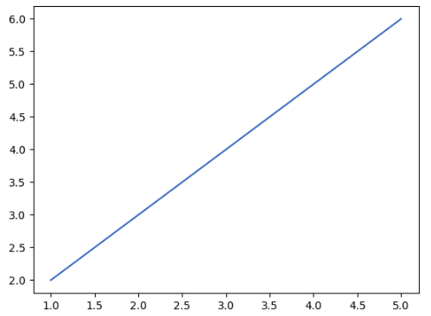

Slide 49
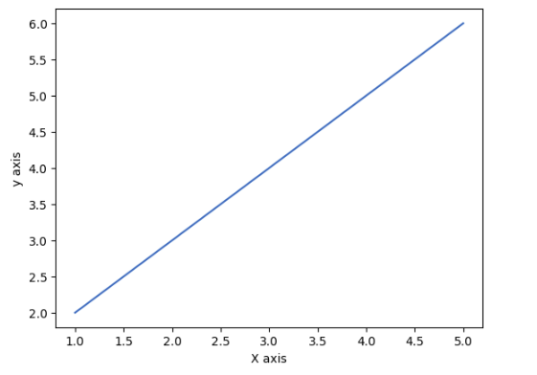

Slide 50
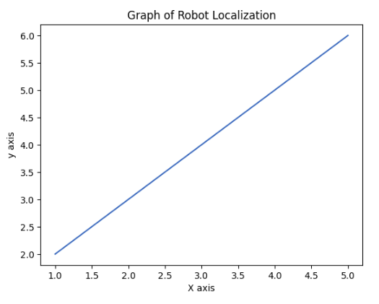

Slide 51
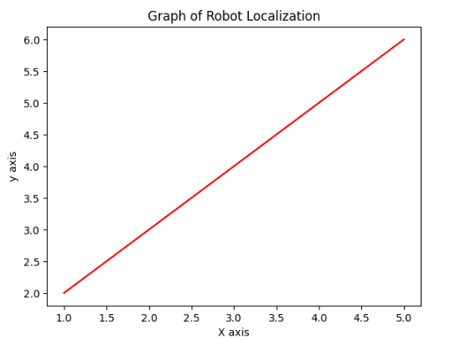

Slide 52
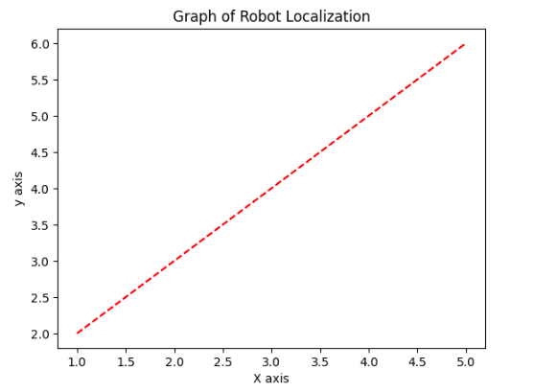

Slide 53


Slide 54
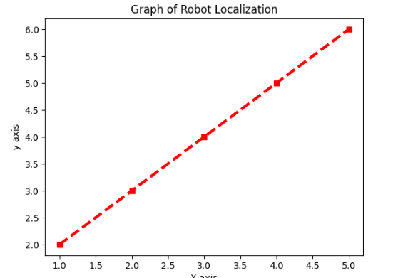

Slide 55
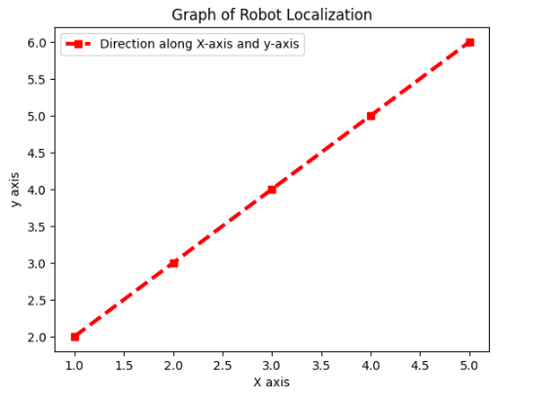

Slide 56
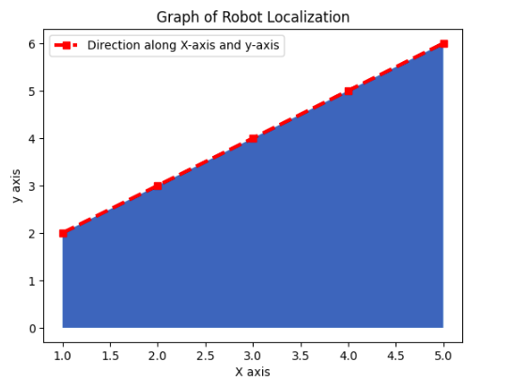

Slide 57
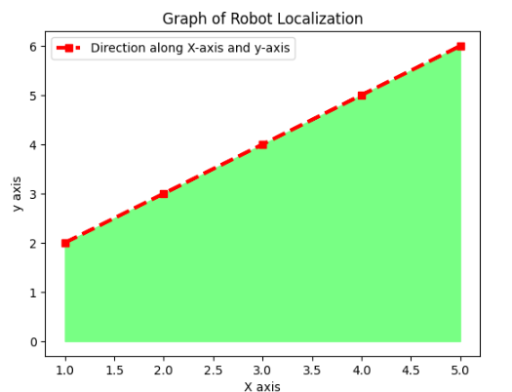

Slide 58
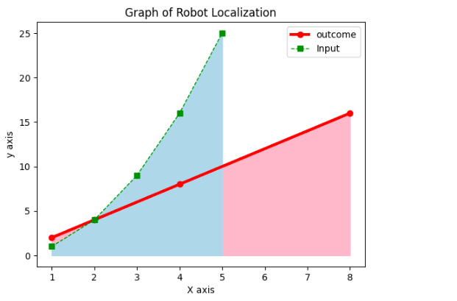
Draw the given Graph

Slide 59
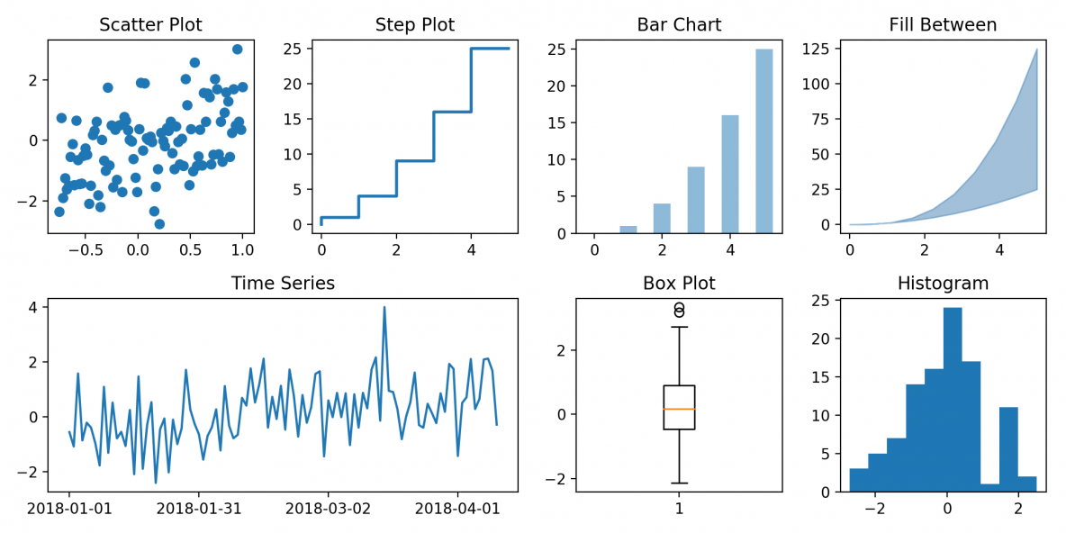

Slide 60
Plotting x and y points
import numpy as np
import matplotlib.pyplot as plt
xpoints = np.array([1,8])
ypoints = np.array([3,10])
plt.plot(xpoints, ypoints)
plt.show()

Slide 61
More Expressive Graph
import numpy as np
import matplotlib.pyplot as plt
x = [1, 2, 3, 4, 5]
y = [1, 4, 9, 16, 25]
plt.plot(x, y, marker='s', linestyle='--', color='r', linewidth=‘3, label='x vs y’) #Styling
plt.xlabel('X Axis') #label on x axis
plt.ylabel('Y Axis') #label on y axis
plt.title('Two Plots Example') #Title
plt.legend() #legend
plt.fill_between(x, y) #fill
plt.grid(True) #grid
plt.show()

Slide 62
Plotting Without Line
plt.plot(xpoints, ypoints, 'o')

Slide 63
Plot 2 lines in a graph
xpoints = np.array([1, 8, 9,10])
ypoints = np.array([3, 10, 13,15])
plt.plot(xpoints, ypoints)
x = [1, 2, 3, 4, 5]
y = [1, 4, 9, 16, 25]
plt.plot(x, y)

Slide 64
Draw a Graph without Array
import matplotlib.pyplot as plt
x = [1, 2, 3, 4, 5]
y = [1, 4, 9, 16, 25]
plt.plot(x, y)
plt.show()

Slide 65
# Adding title and labels
plt.title(My First Ai Plot')
plt.xlabel('X-axis')
plt.ylabel('Y-axis')

